Slide 1
BANKING SYSTEM
CONCEPTUAL PART

Slide 2
customer
Account
Transaction
loan
Cust id | First name | Last name | Date of birth | address | Phone num | email | Acc num
Acc num | Acc type | balance | Date opened | Interest rate | Customer id
Trans id | Trans date | amount | Trans type | Acc num | Emp id
Loan id | Loan type | amount | Interest rate | Start date | End date | Customer id

Slide 3
Employee
Branch
Loan payment
ATM
Card
Emp id | First name | Last name | position | Hire date | department | Branch id
Branch id | Branch name | location | Manager id
Pay id | Pay date | amount | Loan id
Atm id | location | Branch id | status
Card id | Card type | Cust id | Card num | Expire date | cvv | Acc id

Slide 4
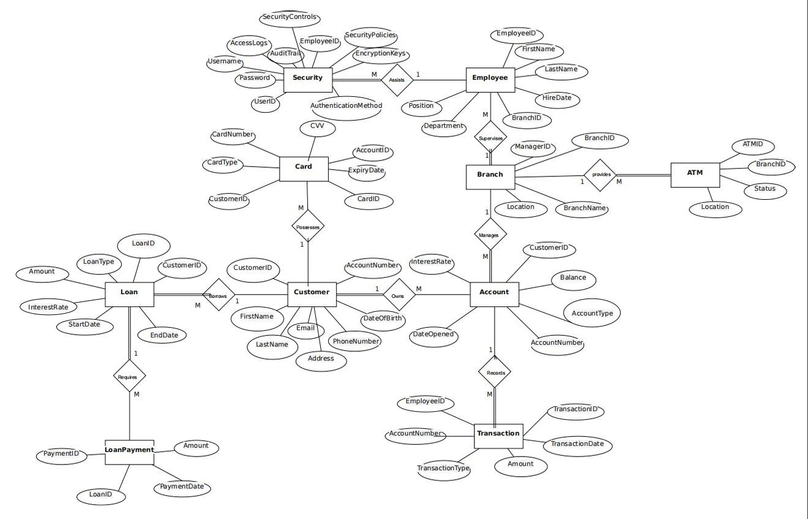

Slide 5
1. Customer - Account: - Relationship: One-to-Many - Description: A customer owns multiple accounts.
2. Branch - Employee: - Relationship: One-to-Many - Description: A branch allocates multiple employees.
3. Account - Transaction: - Relationship: One-to-Many - Description: An account executes multiple transactions. 4. Employee-Security -Relationship: One-to-Many -Description: An employee access multiple security log entries.

Slide 6
5. Customer - Loan: - Relationship: One-to-Many - Description: A customer borrow loans.
6. Loan – Loan Payment: - Relationship: One-to-Many - Description: A loan payment repay loan.
7. Customer - Card: - Relationship: One-to-Many - Description: A customer holds multiple cards.
8. Branch - ATM: - Relationship: One-to-Many - Description: A branch operates multiple ATMs.

